Slide 1

Fake Review Detection

Slide 2



Team Members
Tarun Kumar Punna
Worked as a Machine Learning Engineer & has two years’ experience as a Data Analyst.
Skilled in Machine Learning, Computer Vision, Python, BI tools like Tableau, Power BI.
Srihitha Pasupuleti
Worked at Infosys for 2 years as Java Developer
Skilled in in software and programming languages like Python, Tableau and Data Analysis.
Mohit Mendi
Worked at Dell for 1 year as RPI Developer.
Skilled and experience in software and programming languages e.g. Java, C#.

Slide 3
INTRODUCTION
As most of the people require review about a product before spending their money on the product. So, people come across various reviews on the website, but these reviews are genuine, or fake is not identified by the user. In some review websites some good reviews are added by the product company people itself in order to make in order to produce false positive product reviews. To find out fake review on the website this “Fake Product Review Monitoring System” is introduced. This system will find out fake reviews made by posting fake comments about a product by identifying the IP address along with review posting patterns.

Slide 4
Abstract
The scope and need of online markets and e-commerce platforms are on the rise and many people buy products from these platforms. The number of feedbacks for products as a result are also present in detail for users to analyze the product they are buying. This can work against the users as well because users can sometime bombard the review section with extreme opinion comments which can work in favor or against the product. Thus, we need to take care of this because this can be done either by the merchant to increase the value of his product or the user to degrade the ratings of that product.

Slide 5
Features:
Sentimental Analysis
Content Similarity
Latent Semantic analysis (LSA)

Slide 6
Sentimental Analysis
Sentiment analysis (or opinion mining) is a natural language processing technique used to determine whether data is positive, negative or neutral. Sentiment analysis is often performed on textual data to help businesses monitor brand and product sentiment in customer feedback and understand customer needs.

Slide 7
Content Similarity
With cosine similarity, we need to convert sentences into vectors. Difference in the angle of these determines the similarity between two reviews.

Slide 8
Latent Semantic Analytics
Latent Semantic Analysis is an efficient way of analyzing the text and finding the hidden topics by understanding the context of the text. Latent Semantic Analysis(LSA) is used to find the hidden topics represented by the document or text. These hidden topics then are used for clustering the similar documents together.

Slide 9
Methods:
Reviews which have dual view
Reviews which are posted as flood by same user all the reviews are either positive or negative.
Reviews in which person from same IP Address promoting or demoting a particular brand
Reviews in which same user promoting or demoting a particular brand

Slide 10
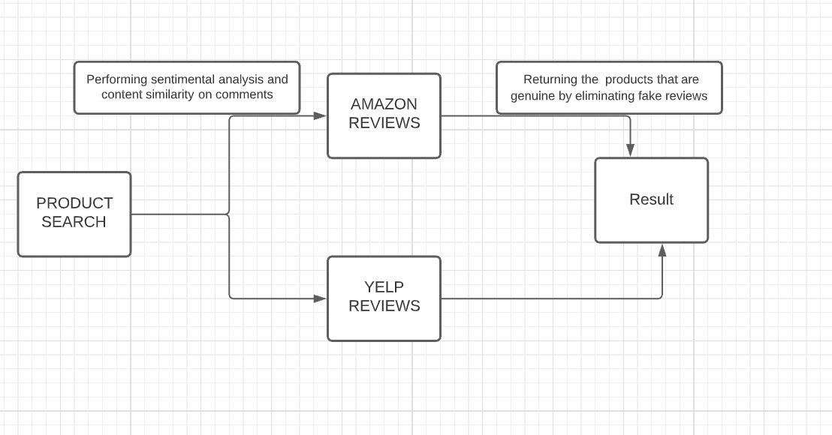
Use Case

Slide 11
GitHub:
https://github.com/tarunpunna/Fake_Product_Detection.git

